Slide 1
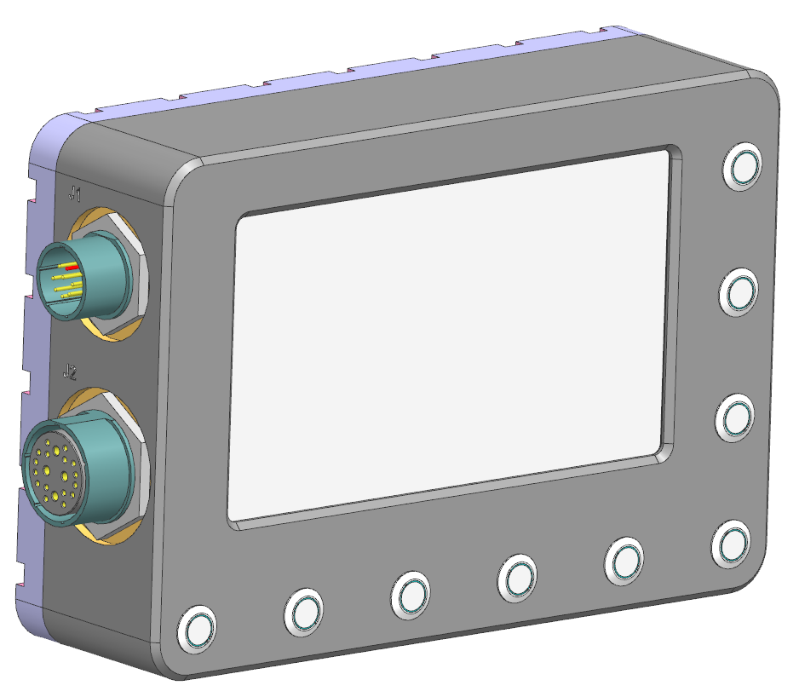
Video Display Unit
Item | Buttons | Functions
1 | Front | Front camera view toggle
2 | Rear | Rear camera view toggle (for both rear near and rear far cameras)
3 | IR | IR illuminator on/off toggle
4 | NUC* | Manual NUC trigger
5 | Night | Low-brightness Night Mode toggle
6 | - | Selection for brightness / contrast / functions settings
7 | +
8 | Menu
9 | Power | Power on/off toggle, 2s holding, default on
9
8
7
6
4
5
2
3
1

Slide 2
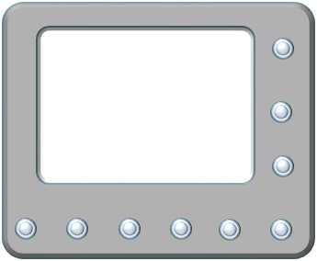
Video Display Unit – Displayed View
Boot up state: Rear Near View
If Forward gear is activated,
View auto change to Rear Far View
Driver can use “Rear” button on VDU to toggle between Rear Near & Rear Far views
Driver can switch to Front TI View at any time using “Front” button on VDU
To switch back to desired rear views, use “Rear” button to toggle the views
If Reverse gear is activated,
View auto change to Rear Near View
Driver can use “Rear” button to toggle between Rear Near & Rear Far view
Driver can switch to Front TI View at any time using “Front” button on VDU
To switch back to desired rear views, use “Rear” button to toggle the views
Activate Reverse Gear*
Press Rear View Button
or
Activate Forward Gear*
Press Rear View Button
or
Activate Reverse Gear*
Front TI View
Rear Far View
Rear Near View
(Default Boot Up View)
Press Rear View Button
or
Activate Forward Gear*
Press Front View Button
Press Front View Switch

Slide 3
J6 - D38999/24WE35SN
26 | DI+1 | Trailer
27 | DI-1
28 | DI+2 | Reverse Gear
29 | DI-2
30 | DI+3 | Forward Gear
31 | DI-3
43 | DO+1 | IR Control
44 | DO-1
Discrete Video Switching
When reverse gear is activated, J6 pin 28 is always HIGH
When J6 pin 28 changes from low to HIGH, the VCU should switch the VDU output (J7 pin 1) ONCE to the Rear Near view (J4 pin B)
When forward gear is activated, J6 pin 30 is always HIGH
When J6 pin 30 changes from low to HIGH, the VCU should switch the VDU output (J7 pin 1) ONCE to the Rear Far view (J4 pin C)
VDU Button Switching
When FRONT button is pressed on VDU, the VDU should send an RS422 message to the VCU. The VCU should switch the VDU output (J7 pin 1) to the front TI view (J4 pin A)
When the REAR button is pressed on the VDU, the VDU should send an RS422 message to the VCU. The VCU should check what the current view is.
If the current view is front TI or Rear Near, change the VDU output (J7 pin 1) to the Rear Far view (J4 pin C)
If the current view is Rear Far, change the VDU output (J7 pin 1) to the Rear Near view (J4 pin B)
Initial boot up state: Rear Near view
J4 - TV07RW-17-20SN
A | HD-SDI INPUT 1 | Front TI
B | HD-SDI INPUT 2 | Rear Near
C | HD-SDI INPUT 3 | Rear Far
D | HD-SDI INPUT 4 | Trailer
J7 - D38999/24WG11SN
A | HD-SDI OUTPUT 1 | VDU

Slide 4
J6 - D38999/24WE35SN
26 | DI+1 | Trailer
27 | DI-1
28 | DI+2 | Reverse Gear
29 | DI-2
30 | DI+3 | Forward Gear
31 | DI-3
43 | DO+1 | IR Control
44 | DO-1
Action | Current View State | Output | Expected Result
J6 pin 28 change from low to HIGH | - | J7 pin A change to J4 pin B | VDU output switch to rear near view
J6 pin 30 change from low to HIGH | - | J7 pin A change to J4 pin C | VDU output switch to rear far view
FRONT button pressed on VDU | - | J7 pin A change to J4 pin A | VDU output switch to front TI view
REAR button pressed on VDU | Front TI | J7 pin A change to J4 pin C | VDU output switch to rear far view
REAR button pressed on VDU | Rear Near | J7 pin A change to J4 pin C | VDU output switch to rear far view
REAR button pressed on VDU | Rear Far | J7 pin A change to J4 pin B | VDU output switch to rear near view
J4 - TV07RW-17-20SN
A | HD-SDI INPUT 1 | Front TI
B | HD-SDI INPUT 2 | Rear Near
C | HD-SDI INPUT 3 | Rear Far
D | HD-SDI INPUT 4 | Trailer
J7 - D38999/24WG11SN
A | HD-SDI OUTPUT 1 | VDU
If the current VDU view state and the expected view state is the same, there should be NO switching
* Supplier to advise VCU-VDU RS422 communications protocol

