Slide 1
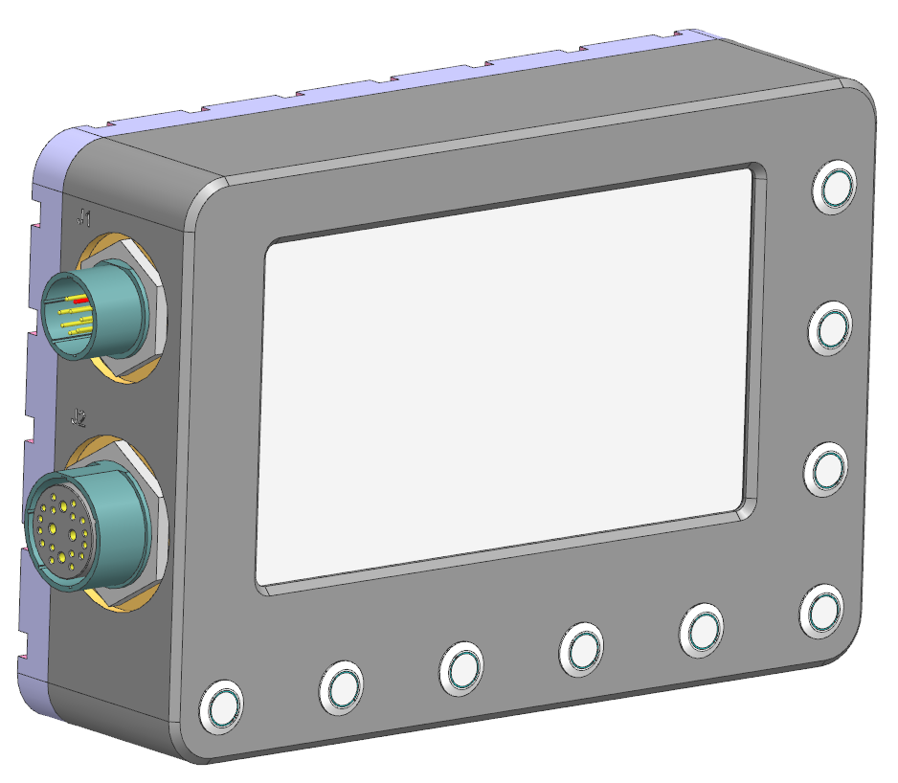
Video Display Unit
Item | Buttons | Functions
1 | Front | Front camera view toggle
2 | Rear | Rear camera view toggle (for both rear near and rear far cameras)
3 | IR | IR illuminator on/off toggle
4 | NUC* | Manual NUC trigger
5 | Night | Low-brightness Night Mode toggle
6 | - | Selection for brightness / contrast / functions settings
7 | +
8 | Menu
9 | Power | Power on/off toggle, 2s holding, default on
9
8
7
6
4
5
2
3
1

Slide 2
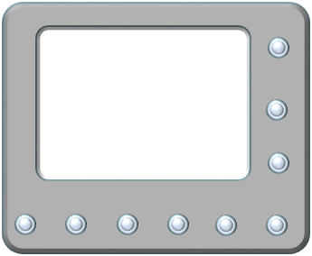
Video Display Unit – Displayed View
Boot up state: Rear Near View
If Forward gear is activated,
  View auto change to Rear Far View
  Driver can use “Rear” button on VDU to toggle between Rear Near & Rear Far views
  Driver can switch to Front TI View at any time using “Front” button on VDU
  To switch back to desired rear views, use “Rear” button to toggle the views
If Reverse gear is activated,
  View auto change to Rear Near View
  Driver can use “Rear” button to toggle between Rear Near & Rear Far view
  Driver can switch to Front TI View at any time using “Front” button on VDU
  To switch back to desired rear views, use “Rear” button to toggle the views
Activate Reverse Gear*
Press Rear View Button
or
Activate Forward Gear*
Press Rear View Button
or
Activate Reverse Gear*
Front TI View
Rear Far View
Rear Near View
(Default Boot Up View)
Press Rear View Button
or
Activate Forward Gear*
Press Front View Button
Press Front View Switch

Slide 3
J6 - D38999/24WE35SN
26 | DI+1 | Trailer
27 | DI-1
28 | DI+2 | Reverse Gear
29 | DI-2
30 | DI+3 | Forward Gear
31 | DI-3
43 | DO+1 | IR Control
44 | DO-1
45 | DO+2 | IR Control
46 | DO+2
Discrete Video Switching
When reverse gear is activated, J6 pin 28 is always HIGH
When J6 pin 28 changes from low to HIGH, the VCU should switch the VDU output (J7 pin 1) ONCE to the Rear Near view (J4 pin B)
When forward gear is activated, J6 pin 30 is always HIGH
When J6 pin 30 changes from low to HIGH, the VCU should switch the VDU output (J7 pin 1) ONCE to the Rear Far view (J4 pin C)
VDU Button Switching
When FRONT button is pressed on VDU, the VDU should send an RS422 message to the VCU. The VCU should switch the VDU output (J7 pin 1) to the front TI view (J4 pin A)
When the REAR button is pressed on the VDU, the VDU should send an RS422 message to the VCU. The VCU should check what the current view is.
  If the current view is front TI or Rear Near, change the VDU output (J7 pin 1) to the Rear Far view (J4 pin C)
  If the current view is Rear Far, change the VDU output (J7 pin 1) to the Rear Near view (J4 pin B)
Initial boot up state: Rear Near view
J4 - TV07RW-17-20SN
A | HD-SDI INPUT 1 | Front TI
B | HD-SDI INPUT 2 | Rear Near
C | HD-SDI INPUT 3 | Rear Far
D | HD-SDI INPUT 4 | Trailer
J7 - D38999/24WG11SN
A | HD-SDI OUTPUT 1 | VDU

Slide 4
J6 - D38999/24WE35SN
26 | DI+1 | Trailer
27 | DI-1
28 | DI+2 | Reverse Gear
29 | DI-2
30 | DI+3 | Forward Gear
31 | DI-3
43 | DO+1 | IR Control
44 | DO-1
45 | DO+2 | IR Control
46 | DO+2
Action | Current View State | Output | Expected Result
J6 pin 28 change from low to HIGH | - | J7 pin A change to J4 pin B | VDU output switch to rear near view
J6 pin 30 change from low to HIGH | - | J7 pin A change to J4 pin C | VDU output switch to rear far view
FRONT button pressed on VDU | - | J7 pin A change to J4 pin A | VDU output switch to front TI view
REAR button pressed on VDU | Front TI | J7 pin A change to J4 pin C | VDU output switch to rear far view
REAR button pressed on VDU | Rear Near | J7 pin A change to J4 pin C | VDU output switch to rear far view
REAR button pressed on VDU | Rear Far | J7 pin A change to J4 pin B | VDU output switch to rear near view
J4 - TV07RW-17-20SN
A | HD-SDI INPUT 1 | Front TI
B | HD-SDI INPUT 2 | Rear Near
C | HD-SDI INPUT 3 | Rear Far
D | HD-SDI INPUT 4 | Trailer
J7 - D38999/24WG11SN
A | HD-SDI OUTPUT 1 | VDU
If the current VDU view state and the expected view state is the same, there should be NO switching
* Supplier to advise VCU-VDU RS422 communications protocol

Slide 5
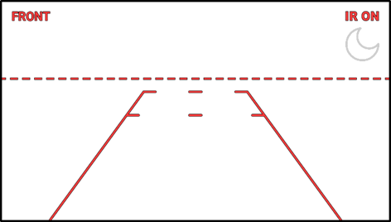
J6 - D38999/24WE35SN
43 | DO+1 | IR Control
44 | DO-1
45 | DO+2 | IR Control
46 | DO+2
Action | Current State | Output | Expected Result
Press “IR” button on VDU | IR Off | J6 pin 43 and 45 HIGH | IR turns on, VDU shows “IR On” OSD
Press “IR” button on VDU | IR On | J6 pin 43 and 45 LOW | IR turns off, VDU removes “IR On” OSD
Press “Night” button on VDU | Night mode OFF | VDU turns to ultra-low brightness | Night Mode OSD shown on VDU
Press “Night” button on VDU | Night mode ON | VDU returns to previous brightness setting | Night Mode OSD removed on VDU
J4 - TV07RW-17-20SN
A | HD-SDI INPUT 1 | Front TI
B | HD-SDI INPUT 2 | Rear Near
C | HD-SDI INPUT 3 | Rear Far
D | HD-SDI INPUT 4 | Trailer
11 | RS422_TX1+ | RS422 to TI
12 | RS422_TX1-
13 | RS422_Shield1
14 | RS422_RX1+
15 | RS422_RX1_
16 | RS422_Shield1
“IR On” OSD
Night Mode OSD
J7 - D38999/24WG11SN
A | HD-SDI OUTPUT 1 | VDU

Slide 6
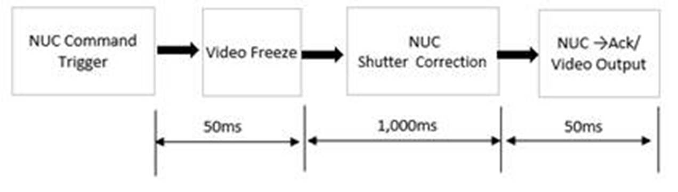
J6 - D38999/24WE35SN
43 | DO+1 | IR Control
44 | DO-1
45 | DO+2 | IR Control
46 | DO+2
Action | Current State | Output | Expected Result
Press “NUC” button | - | VDU tells VCU to send RS422 message “CC0311000000000113” to TI (J4) | TI performs NUC, VDU shows “NUC now” OSD for 1.1s or until Ack message is received from TI (J4 RS422)
J4 - TV07RW-17-20SN
A | HD-SDI INPUT 1 | Front TI
B | HD-SDI INPUT 2 | Rear Near
C | HD-SDI INPUT 3 | Rear Far
D | HD-SDI INPUT 4 | Trailer
11 | RS422_TX1+ | RS422 to TI
12 | RS422_TX1-
13 | RS422_Shield1
14 | RS422_RX1+
15 | RS422_RX1_
16 | RS422_Shield1
Function | Command | Ack
Shutter Correction | CC0311000000000113 | 5502 1100 13
Press “NUC” button on VDU
VCU sends RS422 message to TI
Start showing “NUC now” OSD
Stop showing “NUC now” OSD
J7 - D38999/24WG11SN
A | HD-SDI OUTPUT 1 | VDU
Icon height shall not be larger than 10% of V
“NUC now” OSD (Sample)
* May be shifted if it overlaps with lane markers
To be in white

Slide 7
J6 - D38999/24WE35SN
43 | DO+1 | IR Control
44 | DO-1
45 | DO+2 | IR Control
46 | DO+2
Action | Output | Expected Result
Nothing (Auto NUC mode) | Every 5min, VDU shows the “NUC countdown” OSD, then tells VCU to send RS422 message “CC0311000000000113” to TI (J4) | VDU shows the “NUC countdown” OSD for 5s. At the end of the countdown animation, TI performs shutter NUC and VDU displays “NUC now” OSD for 1.1s or until Ack message is received from TI
J4 - TV07RW-17-20SN
A | HD-SDI INPUT 1 | Front TI
B | HD-SDI INPUT 2 | Rear Near
C | HD-SDI INPUT 3 | Rear Far
D | HD-SDI INPUT 4 | Trailer
11 | RS422_TX1+ | RS422 to TI
12 | RS422_TX1-
13 | RS422_Shield1
14 | RS422_RX1+
15 | RS422_RX1_
16 | RS422_Shield1
Function | Command | Ack
Shutter Correction | CC0311000000000113 | 5502 1100 13
Show “NUC countdown” OSD for 5s
VCU sends RS422 message to TI
To be in white
Start showing “NUC now” OSD
Stop showing “NUC now” OSD
J7 - D38999/24WG11SN
A | HD-SDI OUTPUT 1 | VDU
Trigger TI NUC after countdown finishes
“NUC Countdown” OSD (Sample)

Slide 8
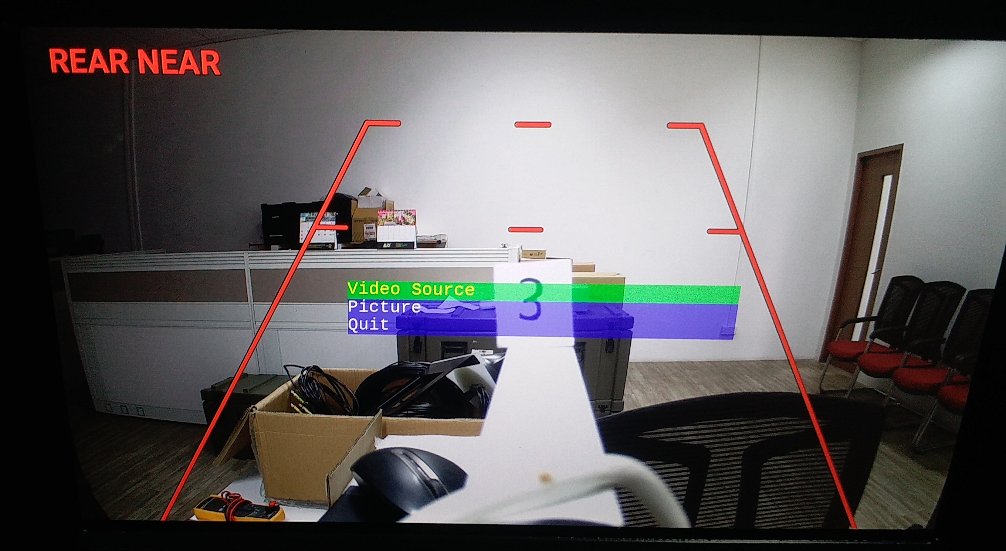
NUC Development Mode
Video Source
Picture
NUC Mode
Quit
1) Press “MENU” button to open menu
2) Press “+” twice to highlight “NUC Mode”
3) Press “NUC” button 3 times to activate NUC Development Mode
4) VCU to send “CC050D00000000000000008D85” message to TI to activate software NUC mode
5) When Ack message “5502 0D8D 82” is received, NUC development mode is activated
Video Source
Picture
NUC Mode
Quit
Video Source
Picture
NUC Mode: Development Mode
Quit
+
Move green highlight UP
-
Move green highlight DOWN
6) Press “+” to highlight “Quit”
7) Press “MENU” button to exit

Slide 9
Default NUC Mode: Auto-NUC Mode
Every 5min,
VDU will show “NUC countdown” animation for 5s
After animation is over, VDU sends NUC command to VCU via RS422
VCU sends NUC message to TI (CC0311000000000113) via RS422
VDU will show “NUC now” OSD for 1.1s while TI image will freeze during NUC
Disable NUC Development Mode
Video Source
Picture
NUC Mode: Development Mode
Quit
1) Press “MENU” button to open menu
2) Press “+” twice to highlight “NUC Mode”
3) Press “NUC” button 3 times to deactivate NUC Development Mode
4) VCU to send “-” message to TI to deactivate software NUC mode
5) When Ack message “5502 0D8D 82” is received, NUC development mode is deactivated
NUC Development Mode
When development mode is activated,
Disable 5min interval NUC countdown and activation
The TI will use software-based NUC
Manual NUC button press (any mode)
When NUC button on VDU is pressed by user,
The VDU will immediately trigger VCU to send NUC message to TI (CC0311000000000113) via RS422
VDU will show “NUC now” OSD for 1.1s while TI image will freeze during NUC
Video Source
Picture
NUC Mode
Quit
6) Press “+” to highlight “Quit”
7) Press “MENU” button to exit
8) VDU will activate manual NUC every 5 min
* On VDU start-up, will be Auto-NUC Mode by default

Slide 10
J4 - TV07RW-17-20SN
A | HD-SDI INPUT 1 | Front TI
B | HD-SDI INPUT 2 | Rear Near
C | HD-SDI INPUT 3 | Rear Far
D | HD-SDI INPUT 4 | Trailer
DDS Message* | Switching Type | Output | Expected Result
Output X requests Stream Y | HD-SDI | J7 output X switches to J4/J5 input Y | Display X shows video stream Y
Output 1 requested Stream Y | HD-SDI | No change | Reject changing of VDU view through network message
1x-4x stream requested on GigE | Network | GigE 2 streams 1-4x selected streams | Requested 1-4x streams available to pull from network switch
Request to stream input 9 or 10 | Network | Ignore | Stream the other requested videos
J5 – D38999/24WE6SN
A | HD-SDI INPUT 5 | Spare
B | HD-SDI INPUT 6 | Spare
C | HD-SDI INPUT 7 | Spare
D | HD-SDI INPUT 8 | Spare
E | HD-SDI INPUT 9 | Cannot compress
F | HD-SDI INPUT 10 | Cannot compress
J7 - D38999/24WG11SN
A | HD-SDI OUTPUT 1 | VDU
B | HD-SDI OUTPUT 2 | WIM 1
C | HD-SDI OUTPUT 3 | WIM 2
D | HD-SDI OUTPUT 4 | WIM 3
E | HD-SDI OUTPUT 5 | FD1
F | HD-SDI OUTPUT 6 | FD2
G | HD-SDI OUTPUT 7 | RD1
H | HD-SDI OUTPUT 8 | RD2
* Refer to VCU IDS excel file
J3 – D38999/24WD35SN
- | GigE 1 | Data LAN
- | GigE 2 | Video LAN
- | GigE 3 | Video LAN Spare

Slide 11
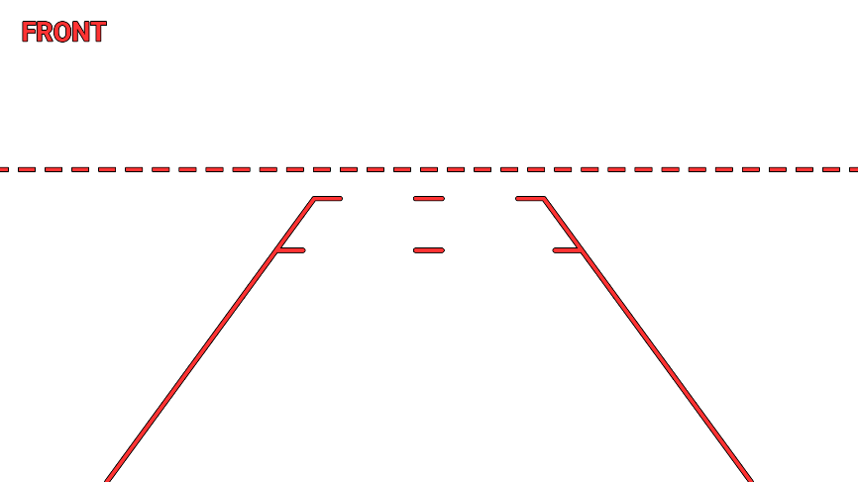
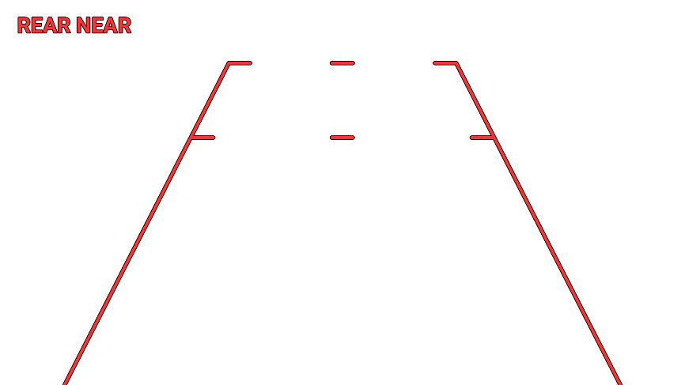
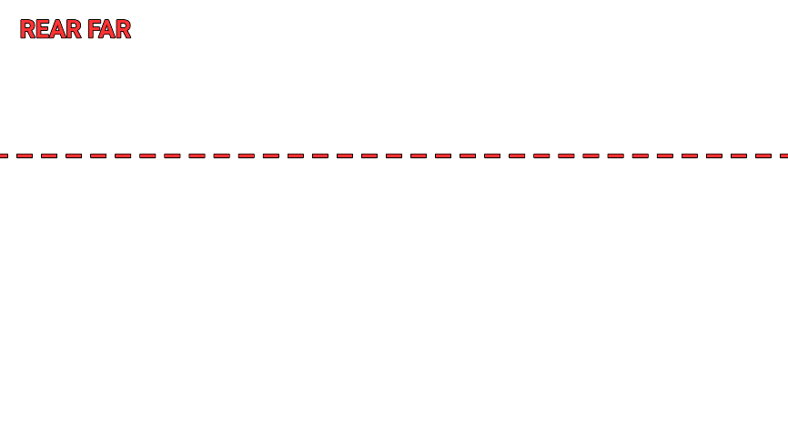

J4 Pin A OSD
J4 Pin B OSD
J4 Pin C OSD
Front TI, IR Off
Rear Near Camera, IR Off
Rear Far Camera, IR Off
Front TI, IR On
Rear Near Camera, IR On
Rear Far Camera, IR On

Slide 12

J4 Pin A OSD
J4 Pin B OSD
J4 Pin C OSD
Front TI, IR Off, Night Mode ON
Rear Near Camera, IR Off, Night Mode ON
Rear Far Camera, IR Off, Night Mode ON
Front TI, IR On, Night Mode ON
Rear Near Camera, IR On , Night Mode ON
Rear Far Camera, IR On , Night Mode ON

Slide 13
Video Display Unit – Displayed View (Trailer Connected)
Rear View toggle /
Reverse Gear engage
Forward Gear engage
Rear View toggle /
Reverse Gear engage
Forward Gear engage
Reverse Gear engage
Front TI View
Rear Near View
(Default Boot Up View)
Rear Far View
Trailer View
Front View toggle
Rear View toggle
Rear View toggle /
Forward Gear engage
Front View toggle
Front View toggle
*Provisionary switching behavior (subject to change) [lower priority to implement]

Slide 14
* J6 Pin 26 HIGH (Trailer Connected Mode)
J6 - D38999/24WE35SN
26 | DI+1 | Trailer
27 | DI-1
28 | DI+2 | Reverse Gear
29 | DI-2
30 | DI+3 | Forward Gear
31 | DI-3
43 | DO+1 | IR Control
44 | DO-1
45 | DO+2 | IR Control
46 | DO+2
Action | Current View State | Output | Expected Result
J6 pin 28 change from low to HIGH (Reverse Gear) | - | J7 pin A change to J4 pin D | VDU output switch to trailer view
J6 pin 30 change from low to HIGH (Forward Gear) | - | J7 pin A change to J4 pin C | VDU output switch to rear far view
FRONT button pressed on VDU | - | J7 pin A change to J4 pin A | VDU output switch to front TI view
REAR button pressed on VDU | Front TI | J7 pin A change to J4 pin D | VDU output switch to trailer view
REAR button pressed on VDU | Trailer | J7 pin A change to J4 pin C | VDU output switch to rear far view
REAR button pressed on VDU | Rear Far | J7 pin A change to J4 pin B | VDU output switch to rear near view
REAR button pressed on VDU | Rear Near | J7 pin A change to J4 pin D | VDU output switch to trailer view
J4 - TV07RW-17-20SN
A | HD-SDI INPUT 1 | Front TI
B | HD-SDI INPUT 2 | Rear Near
C | HD-SDI INPUT 3 | Rear Far
D | HD-SDI INPUT 4 | Trailer
J7 - D38999/24WG11SN
A | HD-SDI OUTPUT 1 | VDU
If the current VDU view state and the expected view state is the same, there should be NO switching

Slide 15
Video Display Unit – Displayed View (Trailer Disconnected)
Rear View toggle /
Forward Gear engage
Rear View toggle /
Reverse Gear engage
Forward Gear engage
Front TI View
Rear Near View
(Default Boot Up View)
Rear Far View
Trailer View
Front View toggle
Rear View toggle /
Reverse Gear engage
Front View toggle
Back to default switching behaviour when trailer disconnected

Slide 16
Summary
J6 - D38999/24WE35SN
26 | DI+1 | Trailer
27 | DI-1
28 | DI+2 | Reverse Gear
29 | DI-2
30 | DI+3 | Forward Gear
31 | DI-3
43 | DO+1 | IR Control
44 | DO-1
45 | DO+2 | IR Control
46 | DO+2
Trailer Status | Action | Current VDU View | Expected VDU View
- | FRONT button pressed on VDU | - | Front TI
- | Forward Gear activated | - | Rear Far
No Trailer | Reverse Gear activated | - | Rear Near
 | REAR button pressed on VDU | Front TI | Rear Far
 |  | Rear Far | Rear Near
 |  | Rear Near | Rear Far
Trailer Connected | Reverse Gear activated | - | Trailer
 | REAR button pressed on VDU | Front TI | Trailer
 |  | Trailer | Rear Far
 |  | Rear Far | Rear Near
 |  | Rear Near | Trailer
J4 - TV07RW-17-20SN
A | HD-SDI INPUT 1 | Front TI
B | HD-SDI INPUT 2 | Rear Near
C | HD-SDI INPUT 3 | Rear Far
D | HD-SDI INPUT 4 | Trailer
J7 - D38999/24WG11SN
A | HD-SDI OUTPUT 1 | VDU
If the current VDU view state and the expected view state is the same, there should be NO switching

