Slide 1
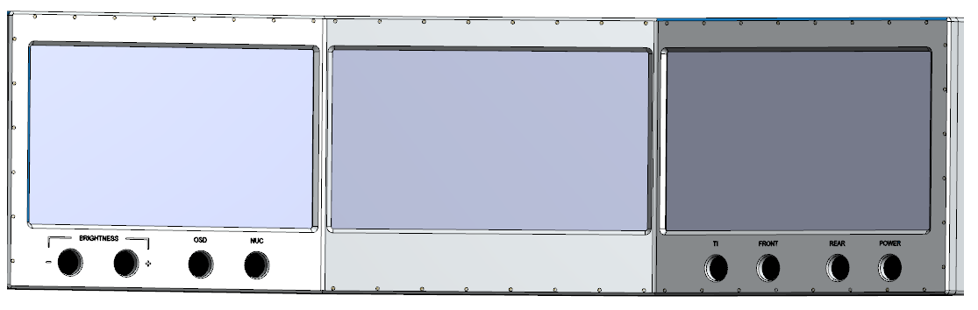
PDR on iDDP--- (Terrex Gen5)
Preliminary Design Review
Feb. 2023

Slide 2
System Physical Structure & Out Dimensions
Draft Version has been sent to STELS on 2 Dec. 2022.
Envelope Size:
714mm (L) x
192mm (D) x
200mm (H)
Screen L/R bend angle: 30º
LCD Active Area:
226mm(W) x 127mm (H)
10.2” diagonal 16:9
FHD display

Slide 3
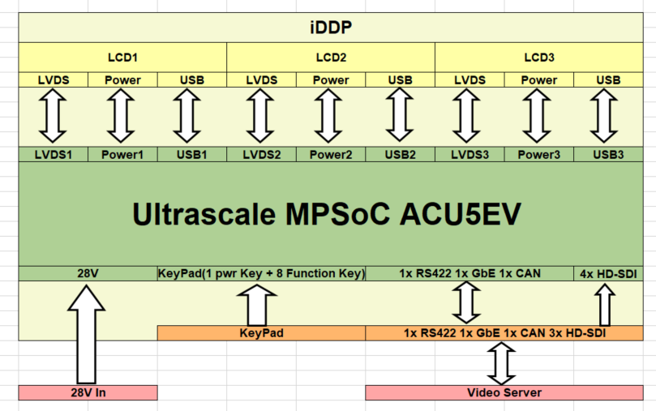
Connections and Interfaces (CFTC)
Power supply
  24VDC
Video Input
  4x HD-SDI
Video Display TFT LCD
  3x FHD 16:9 10.2”
Ethernet ports
  1x GbE LAN
H.264 CODEC
  2x Encoder
  4x Decoder
Engineering Port
  USB2.0 HS x1 port
1 x RS422
1x CANBUS (to Vehicle)
9x press button on panel

Slide 4

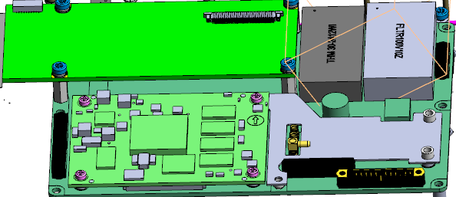
Electronics PCB Architecture
1: Rigid-Flex Cable
2: SoC PCB ACU5EV
3: Interface PCB
1: Rigid-Flex Cable
Item | Description | QTY. | Model
1 | Rigid-Flex-Cable | 1 | iDDP-Rflex-cable
2 | Ultra Scale MPSoC card | 1 | ACU5EV-PCB
3 | Interface PCB | 1 | IDDP-Interface
2: SoC PCB ACU5EV
3: Interface PCB

Slide 5
Interface Control Document
1. External connector J1 ~ J2 pin assignment
Connctor_pinout.xlxs
2. iDDP mounting interface drawing
3. Ethernet LAN connectivity setup and protocol definition
Expected from STELS
4. RS422 connectivity and protocol definition
Expected from STELS
5. Panel buttons operational truth table definition
Expected from STELS
6. CANBUS protocol definition
Expected from STELS

Slide 6
Schematic Design & PCB routine
Layer | Description | QTY. | Model | Schematic design | PCB Routine | Expected completion date of PCBA
1 | Rigid-Flex-Cable | 1 | iDDP-Rflex-cable | Ready | In progress | 1 May 2023
2 | Ultra Scale MPSoC card | 1 | ACU5EV-PCB | Ready | Ready | In Stock
3 | Interface PCB | 1 | IDDP-Interface | Ready | In progress | 1 May 2023
Hardware Test & Integration:
  From 1 April ------to------ 30 May
  If there is no critical fault on design.

Slide 7
Mechanical design & status
Layer | Description | QTY. | Model | Mechanical design | Fabrication drawing | Expected Date of completion
1 | Front cover and housing | 1 | Front-ASSY-iDDP | Ready | Ready | 20 April 2023
1 | Rear cover and housing | 1 | Rear-ASSY-iDDP | Ready | Ready | 1 May 2023
1 | LCD bonding bracket | 1 | LCD-ASSY | Ready | Ready | 1 May 2023
1 | Internal accessories | N | N.A. | Ready | Ready | 15 May 2023
Integration:
  From 1 April ------to------ 30 May
  If there is no critical fault on design.

Slide 8
Major Functions and Performances
User application: Driver Display & Safety
Video component: Driver Aid / Anti Collision / OSD
Intelligent Processing: N.A.
Networking: h.264 stream input
Hardware: LCD display
Glass-to-Glass Latency
HD-SDI input | Network input
<50ms | <200ms
Power consumption (excluding camera power)
Peak power | Continuous power
< 100 watt | < 60 watt

Slide 9
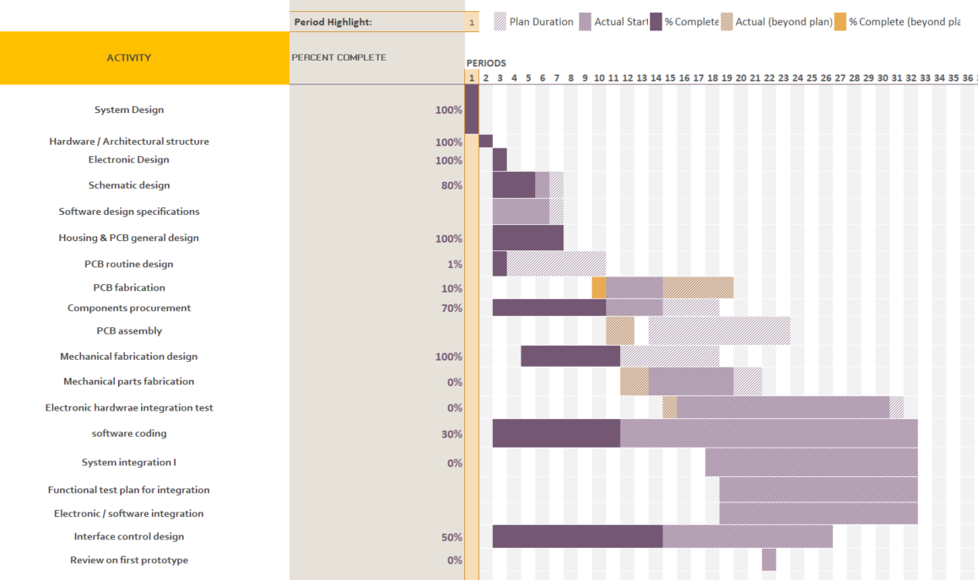
Schedule update
Start Date: 1 Dec. 2022
1st Prototype basic version ready: 30 July 2023

