Slide 1
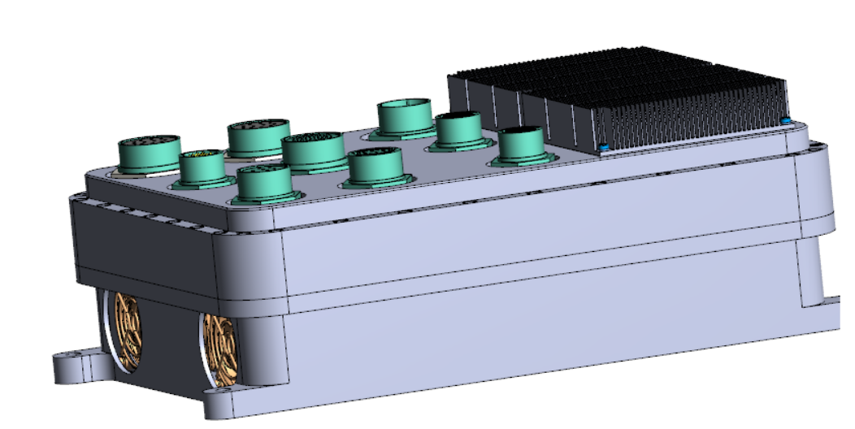
Video Server I--- (Terrex Gen5)
Preliminary Design Review
Feb. 2023

Slide 2
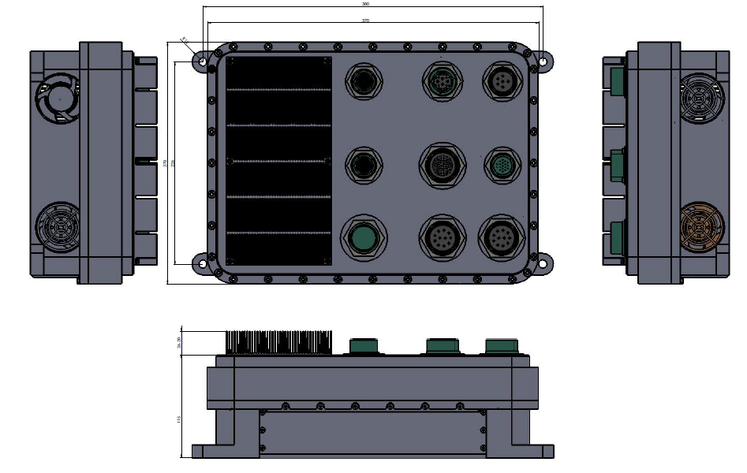
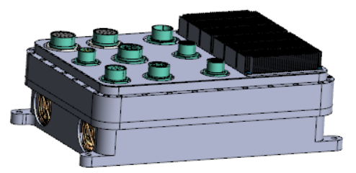
System Physical Structure & Out Dimensions
Draft Version has been sent to STELS on 2 Dec. 2022.
Envelope Size:
388mm (L) x
270mm (W) x
142mm (H)

Slide 3
Connections and Interfaces (CFTC)
Power supply
  24VDC
Video Input
  20x HD-SDI
Video Output
  8x HD-SDI
Ethernet ports
  8x GbE LAN
  1x 10GbE Fiber LAN
H.264 CODEC
  16x Encoder
  16x Decoder
Engineering Port
  USB2.0 HS x1 port
No built-in camera +12VDC output
4x RS232 + 1x audio
4 x RS422 + 1x RS422 (to iDDP)
Optional 2x USB3.0 SSD for recording

Slide 4
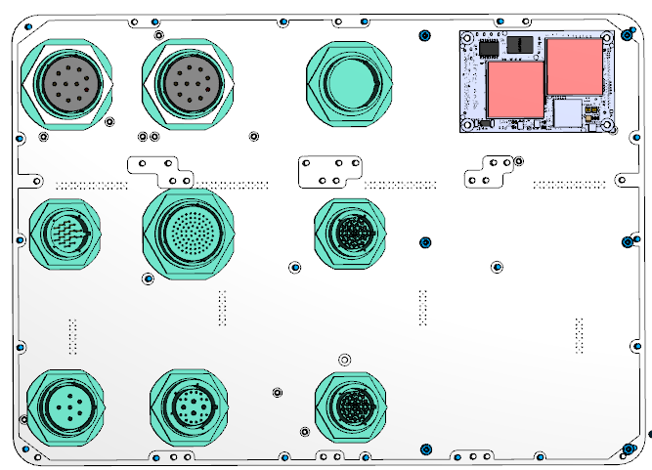
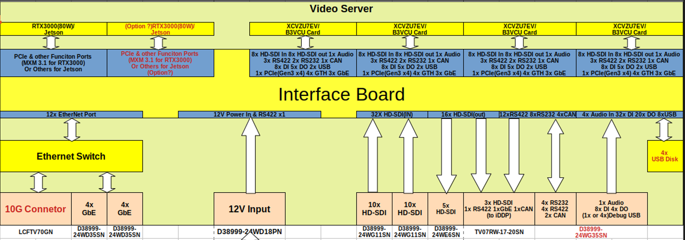
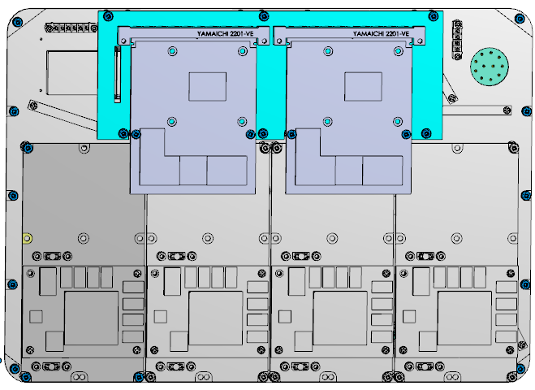
Electronics PCB Architecture
Top Layer 1
Top Layer 4
Layer | Description | QTY. | Model
0 | LAN switch PCBA Module | 1 | EPSM-10GX (COTS)
1 | Panel Interface PCBA | 1 | Gen5-Panel-PCB
2 | Interface-2 PCBA (to SOC) | 4 | Interface-2-PCB
2 | Flex-PCB-Cable | 2 | Flex-PCB
3 | Ultra Scale MPSoC card | 4 | ACU7EV-PCB
4 | MXM3.1 GPU card | 2 | RTX3000

Slide 5
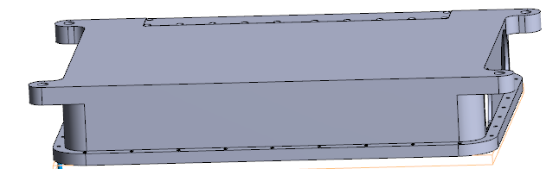
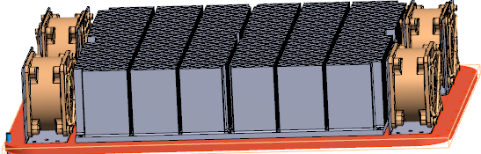
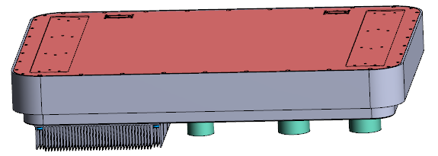
Modular thermal design
Bottom Cover
Thermal Heatsink module
(Flexible to optimize the heat dissipation performance)
Electronic Assembly Module
(IP66, EMI/EMC, MIL-STD-810 Complied)
Design Target: (on casing)
20ºC temperature rise over ambient @ full loading.

Slide 6
Interface Control Document
1. External connector J1 ~ J9 pin assignment
Connctor_pinout.xlxs
2. Video Server E-Box mounting interface drawing
3. Ethernet LAN connectivity setup and protocol definition
Expected from STELS
4. RS422 connectivity and protocol definition
Expected from STELS
5. RS232 setup and protocol definition
Expected from STELS
6. Discrete I/O functional truth table definition
Expected from STELS
7. CANBUS protocol definition
Expected from STELS

Slide 7
Schematic Design & PCB routine
Layer | Description | QTY. | Model | Schematic design | PCB Routine | Expected completion date of PCBA
0 | LAN switch PCBA Module | 1 | EPSM-10GX (COTS) | N.A. | N.A. | In stock
1 | Panel Interface PCBA | 1 | Gen5-Panel-PCB | Ready | In progress | 1 May 2023
2 | Interface-2 PCBA (to SOC) | 4 | Interface-2-PCB | Ready | Ready | 1 April 2023
2 | Flex-PCB-Cable | 2 | Flex-PCB | Ready | In Progress | 15 April 2023
3 | Ultra Scale MPSoC card | 4 | ACU7EV-PCB | Ready | Ready | In stock
4 | MXM3.1 GPU card | 2 | RTX3000 | N.A. | N.A. | In stock
Hardware Test & Integration:
  From 1 April ------to------ 30 May
  If there is no critical fault on design.

Slide 8
Mechanical design & status
Layer | Description | QTY. | Model | Mechanical design | Fabrication drawing | Expected Date of completion
1 | Top cover and housing | 1 | TOP-ASSY-Gen5 | Ready | Ready | 20 April 2023
1 | Heatsink module | 1 | Heat-sink | Ready | Ready | 1 May 2023
1 | Bottom cover and housing | 1 | Bottom_ASSY | Ready | Ready | 1 May 2023
1 | Internal accessories | N | N.A. | Ready | Ready | 15 May 2023
Integration:
  From 1 April ------to------ 30 May
  If there is no critical fault on design.

Slide 9
Major Functions and Performances
User application: Driver Display & Safety / UIT SA / Event Recorder
Functions in Black:
Basic version completed by 30 July.
Functions in RED:
Advanced version completed by 30 September 2023.
Functions in Green:
Final version completed by 30 December 2023.
Video component: Driver Aid / Anti Collision / 3D Driving / Fatigue detect / 360 view / OSD
Intelligent Processing: Classification / Stereo ranging / stitching
Distribution: Network topology / Encoding / Switch / Cable
Hardware: Interfaces to Camera / Computer / Display / SS Recorder
Glass-to-Glass Latency
With iDDP | On Networking
<120ms | <300ms
Power consumption (excluding camera power)
Peak power | Continuous power
< 450 watt | < 300 watt

Slide 10
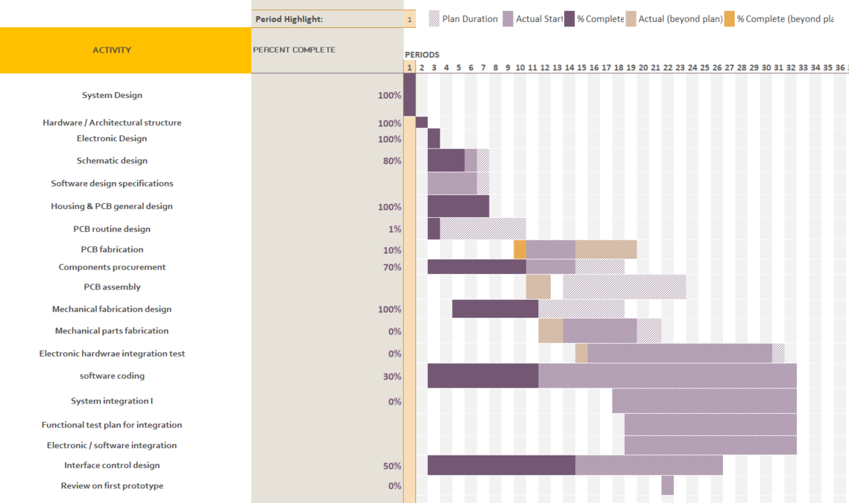
Schedule update
Start Date: 1 Dec. 2022
1st Prototype basic version ready: 30 July 2023

